Slide 1
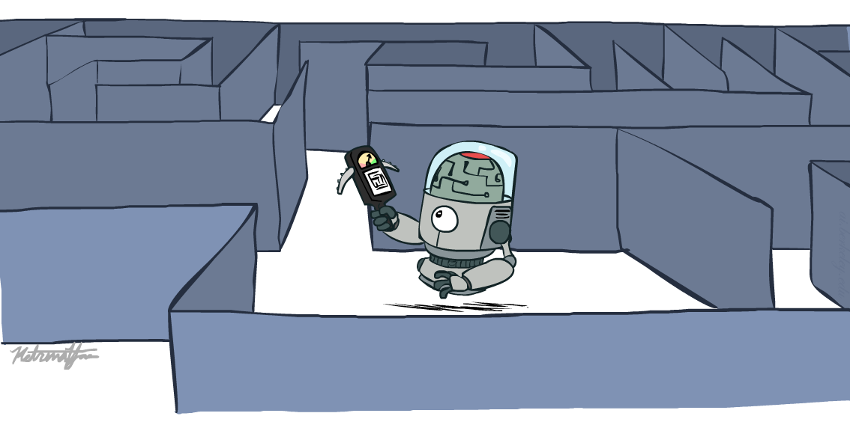
人工智能导论 Introduction To Artificial Intelligence
Search Continued
王进
成都大学信息科学与工程学院

Slide 2

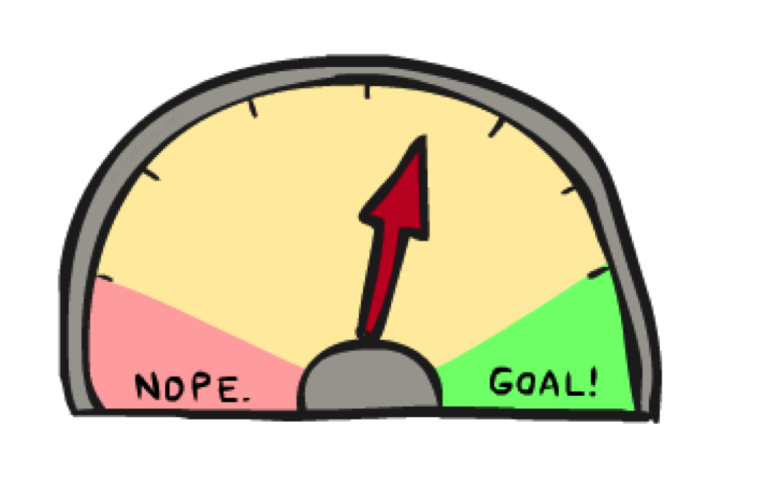
Up next: Informed Search启发式搜索
Uninformed Search盲搜索
DFS
BFS
UCS
Informed Search启发式搜索
Heuristics 启发
Greedy Search 贪婪搜索
A* Search A星搜索
Graph Search 图搜索
Notes:
Blind search vs. “warmer” “colder”
Info about where goal is.
Optimal solution, explore less of the tree.

Slide 3



Search Heuristics搜索启发
A heuristic is启发是:
A function that estimates how close a state is to a goal启发是个函数，用于估算某状态到目标的远近程度
Designed for a particular search problem用于特定搜索问题
Pathing? 寻路
Examples: Manhattan distance, Euclidean distance for pathing 曼哈顿距离，欧式距离
10
5
11.2
Notes:
Function takes a state, returns a number.
Not everyday term. Not “Look both ways before you cross the street”
How far I am? Could run search, but that defeats the purpose!
Not perfect, but something!

Slide 4
Example: Heuristic Function启发式函数
h(x)
Notes:
Another heuristic. Straight line distance (as the crow flies; not as the snail crawls). Better close to Bucharest.
Not always distances, but that’s easiest to understand.
What do you do with it?

Slide 5
Example: Heuristic Function
Heuristic?
E.g. the number of the largest pancake that is still out of place
3
h(x)
4
3
4
3
0
4
4
3
4
4
2
3
Notes:
A* expanded 8100 ; Path cost = 33
UCS expanded 25263 . Path cost = 33
Greedy expanded 10 . Path cost = 41
[0, 7, 5, 3, 2, 1, 4, 6]
(7, 0, 5, 3, 2, 1, 4, 6)
(6, 4, 1, 2, 3, 5, 0, 7)
(3, 2, 1, 4, 6, 5, 0, 7)
(1, 2, 3, 4, 6, 5, 0, 7)
(5, 6, 4, 3, 2, 1, 0, 7)
(6, 5, 4, 3, 2, 1, 0, 7)
(0, 1, 2, 3, 4, 5, 6, 7)

Slide 6

Greedy Search

Slide 7
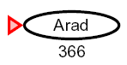
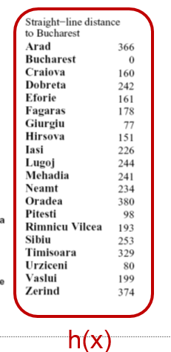
Greedy Search贪婪搜索
Expand the node that seems closest… 优先展开貌似距离目标最近的节点
Is it optimal最优解?
No. Resulting path to Bucharest is not the shortest!不是，所得到Bucharest路径不是最短路径
Notes:
Numbers of heuristic, since that’s what greedy cares about.
Got to Bucharest, but not by shortest path.
End up with some kind of goal, but not what you want. You get a smelly shoe instead of to the airport on time.

Slide 8
Recap上次课内容回顾
DFS, BFS, and Iterative Deepening深度优先与宽度优先
DFS outperforms BFS when the solution located at a quite shallow level. 当解位于比较浅的层时， DFS优于BFS
UCS一致代价搜索
What is Heuristic? 什么是启发
An estimate of distance to the target. 到目标的距离估计
Greedy Search 贪婪搜索
Almost expanding the node seemingly nearest to the target 优先搜索那些似乎距离目标最近的节点

Slide 9
Greedy Search贪婪搜索
b
Strategy: expand a node that you think is closest to a goal state优先展开你认为到目标最近的节点
Heuristic: estimate of distance to nearest goal for each state 启发即是估计当前状态到目标状态的距离
A common case:
Best-first takes you straight to the (wrong) goal 通常首选最好的决策不一定能达到最终目标
Worst-case: like a badly-guided DFS 最坏情况下，贪婪搜索跟DFS一样
…
b
…
[Demo: contours greedy empty (L3D1)]
[Demo: contours greedy pacman small maze (L3D4)]
Notes:
Same algorithm as before, new strategy.
For any search problem, you know the goal. Now, you have an idea of how far away you are from the goal.
Worst: heuristic always wrong. Carefully avoid goal searching all tree.
If your heuristic were really good, sure. But if heuristic is good, easy problem!

Slide 10

Video of Demo Contours Greedy (Empty)
Notes:
Great in an empty maze! Straight to goal, no waste.

Slide 11
Video of Demo Contours Greedy (Pacman Small Maze)
Notes:
Found a path quickly, but wrong one!
Right solution goes backward according to heuristic, and greedy hates that.

Slide 12
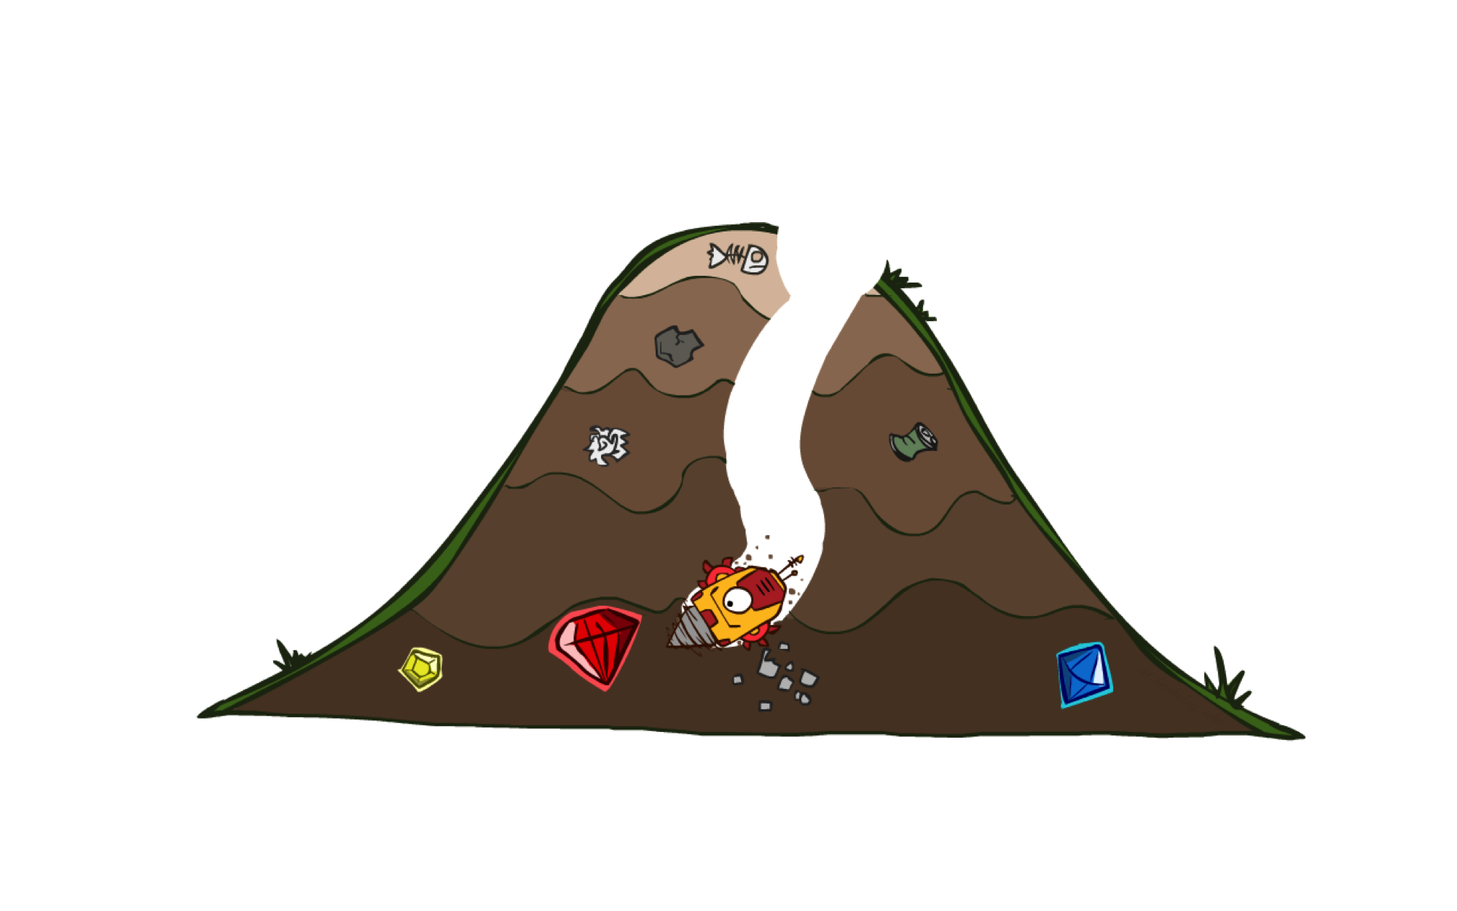
A* Search A星搜索
Notes:
What we’ve been building to. Cornerstone. Goes to the goal like greedy, but backtracks as needed.
When it works, it’s magic!

Slide 13
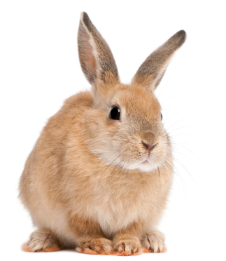
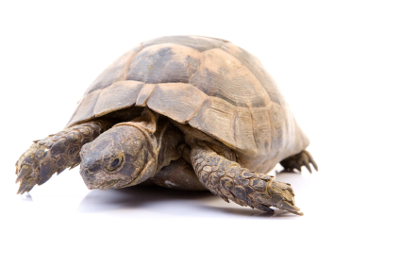

A* Search A星搜索
UCS
Greedy
A*
Notes:
Notes: these images licensed from iStockphoto for UC Berkeley use.
UCS / Greedy
Goal: The thing that should not be! Hedge bets, be directed.

Slide 14
Combining UCS and Greedy结合UCS和贪婪
Uniform-cost orders by path cost, or backward cost g(n)按照路径代价进行展开，简称反向代价g(n)
Greedy orders by goal proximity, or forward cost h(n) 按照到目标的估计距离进行展开，简称前向代价h(n)
A* Search orders by the sum: f(n) = g(n) + h(n)
g = 0 h=6
S
8
g = 1 h=5
a
e
h=1
1
g = 9 h=1
g = 2 h=6
g = 4 h=2
1
3
2
b
d
e
S
a
d
G
h=6
1
h=5
h=2
h=0
g = 10 h=2
g = 3 h=7
g = 6 h=0
1
c
G
d
c
b
h=7
h=6
g = 12 h=0
G
Example: Teg Grenager
Notes:
UCS. Cumulative cost of arcs back to root. backward cost g(n). Computed as you go as part of the fringe.
Greedy. Heuristic forward cost h(n). NOT cumulative. Just a function of the state.
What is A*. Sum of the two! Doesn’t go to c early cuz h is high (far from goal).
Doesn’t do a->e branch g is high (expensive).

Slide 15
When should A* terminate?A星搜索的终止条件
Should we stop when we enqueue a goal?目标进入队列时，A星是否应该终止？
No: only stop when we dequeue a goal A星只在将目标弹出队列时终止
h = 2
g h +
A
2
2
S 0 3 3
S
h = 3
h = 0
G
S->A 2 2 4
S->B 2 1 3
2
B
3
S->B->G 5 0 5
h = 1
S->A->G 4 0 4

Slide 16
Is A* Optimal? A星是否最优？
h = 6
1
A
3
g h +
S 0 7 7
S
h = 7
G
h = 0
S->A 1 6 7
S->G 5 0 5
5
What went wrong?
Actual bad goal cost < estimated good goal cost
We need estimates to be less than actual costs! 启发估计应小于实际代价
Notes:
Dequeue a goal state, got the wrong answer.
Abandon all hope! Heuristic is too high. Overestimated actual cost 3.

Slide 17
Summary
What is Heuristics?
Heuristic is the distance estimate to the goal
Greedy Search
Always choose the path with the least heuristic
Greedy search is faster than UCS, yet not optimal.
A* comes by Combining UCS and Greedy search, yet still problematic.

Slide 18
Homework
Read the reference book 3.4, 3.5.
Project 2 will come soon. Please finish Project1 a.s.a.p.

Slide 19

Admissible Heuristics可采纳启发
Notes:
~10:15am

Slide 20

Idea: Admissibility可采纳性概念
Inadmissible (pessimistic) heuristics
break optimality by trapping good plans on the fringe不可采纳启发会把好的规划困在待展开队列中，破坏求解最优性
Admissible (optimistic) heuristics
slow down bad plans but
never outweigh true costs可采纳启发会阻止不好的规划，且不高估真实代价
Notes:
If heuristic lies, and overestimates. Mistake.
Underestimate might reduce to UCS.

Slide 21


Admissible Heuristics可采纳启发
A heuristic h is admissible (optimistic乐观估计) if:
where is the true cost to a nearest goal
Examples:
Coming up with admissible heuristics is most of what’s involved in using A* in practice. 可采纳启发设计是A星在实际应用的关键
0.0
15
11.5
Notes:
True cost – what we’re trying to solve! Need to prove beforehand.

Slide 22

Optimality of A* Tree Search

Slide 23


Optimality of A* Tree Search
Assume假设:
A is an optimal goal node A是最优目标节点
B is a suboptimal goal node B是次最优目标节点
h is admissible h是可采纳启发
Claim证明:
A will exit the fringe before B A将先于B从队列中弹出
…

Slide 24


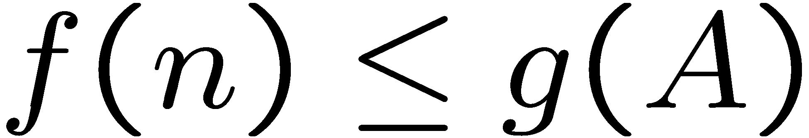
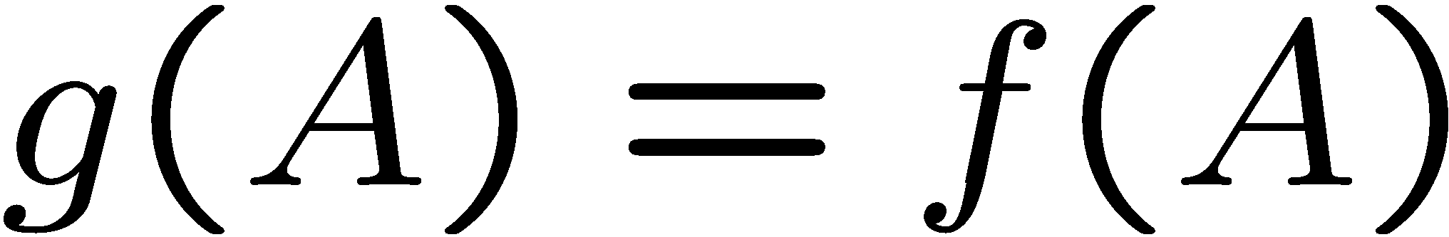
Optimality of A* Tree Search: Blocking
Proof:
Imagine B is on the fringe假定B已经在队列中
Some ancestor n of A is on the fringe, too (maybe A!) A的若干祖先节点n也在队列中
Claim: n will be expanded before B
f(n) is less or equal to f(A)
…
Definition of f-cost
Admissibility of h
h = 0 at a goal

Slide 25


Optimality of A* Tree Search: Blocking
Proof:
Imagine B is on the fringe
Some ancestor n of A is on the fringe, too (maybe A!)
Claim: n will be expanded before B
f(n) is less or equal to f(A)
f(A) is less than f(B)
…
B is suboptimal
h = 0 at a goal

Slide 26

Optimality of A* Tree Search: Blocking
Proof:
Imagine B is on the fringe
Some ancestor n of A is on the fringe, too (maybe A!)
Claim: n will be expanded before B
f(n) is less or equal to f(A)
f(A) is less than f(B)
n expands before B
All ancestors of A expand before B
A expands before B
A* search is optimal
…

Slide 27
Properties of A*
Uniform-Cost
A*
b
b
…
…
“东一下，西一下”
“有的放矢”
Notes:
UCS ragged based on cost.
A* narrows when near goal, heuristic

Slide 28
UCS vs A* Contours
Uniform-cost expands equally in all “directions” UCS 均匀的在所有方向拓展
A* expands mainly toward the goal, but does hedge its bets to ensure optimality A星主要向目标拓展，为了保证最优性，需要权衡启发估计h和实际代价g
Start
Goal
Start
Goal
[Demo: contours UCS / greedy / A* empty (L3D1)]
[Demo: contours A* pacman small maze (L3D5)]
Notes:
~10:30

Slide 29
Video of Demo Contours (Empty) -- UCS
Notes:
Uniform ignores where goal is until you hit it.

Slide 30
Video of Demo Contours (Empty) -- Greedy
Notes:
Goes right there! Fast.

Slide 31
Video of Demo Contours (Empty) – A*
Notes:
Splits the diff.
Heuristic leave open possibility that you’ve gone in the wrong direction.
Maybe going to left has a really, really low cost. Wormhole.
How much trade off is a function of the heuristic. If 0, UCS.

Slide 32
Video of Demo Contours (Pacman Small Maze) – A*
Notes:
Same thing, more complex problem.
Search in ”wrong” direction because heuristic wants to go towards goal.
But find the shortest eventually.

Slide 33



Comparison
Greedy
Uniform Cost
A*

Slide 34
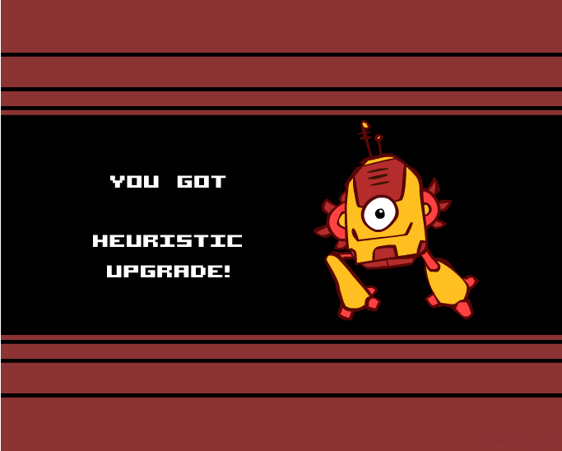
Creating Heuristics
Notes:
Upgrade planning agents with heuristics.
How do we do it?

Slide 35
Creating Admissible Heuristics设计可采纳启发
Most of the work in solving hard search problems optimally is in coming up with admissible heuristics 解决复杂搜索问题的大部分工作是可采纳启发设计
Often, admissible heuristics are solutions to relaxed problems, where new actions are available通常可采纳启发是简化问题的解
Inadmissible heuristics are often useful too
366
15
Notes:
Change problem – same or easier. And cheaper.
Imagine a new direct road.
Walk through walls spell.
Inadmissible – a little bit suboptimal is okay.

Slide 36
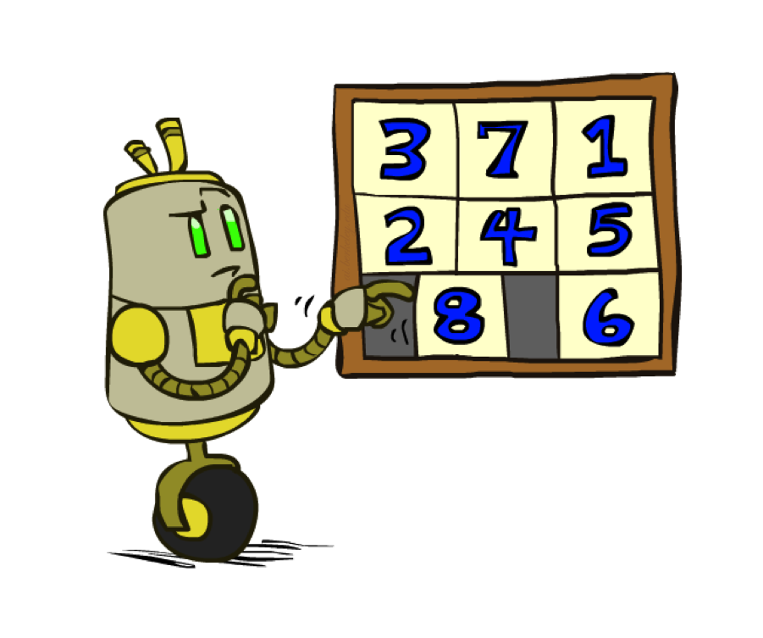
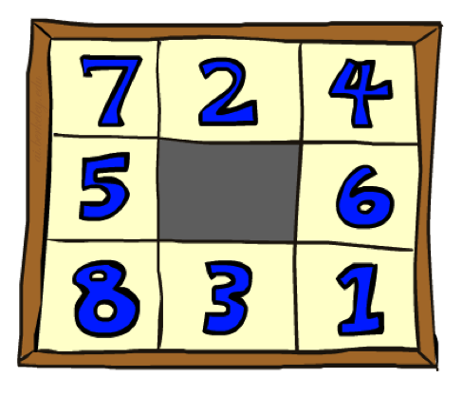
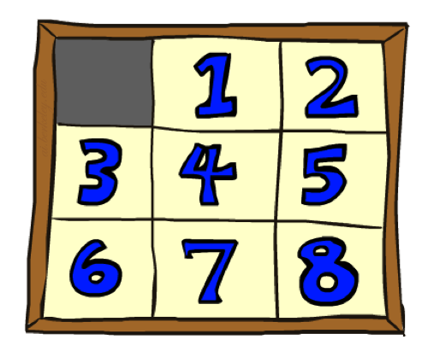
Example: 8 Puzzle
Start State
Actions
Goal State
What are the states? 状态怎么描述
How many states? 状态空间大小
What are the actions? 动作怎么描述？
How many successors from the start state?起始状态有多少后继状态？
What should the costs be? 代价是多少？
Admissible heuristics?可采纳启发
Notes:
Like the xbox of my time.
Branching factor.

Slide 37
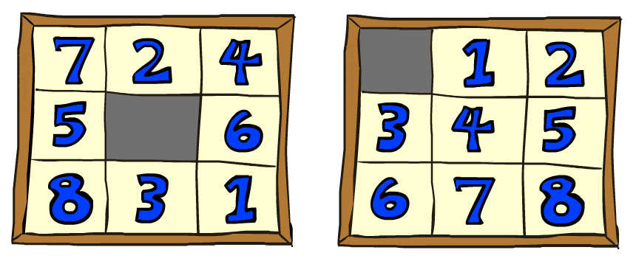
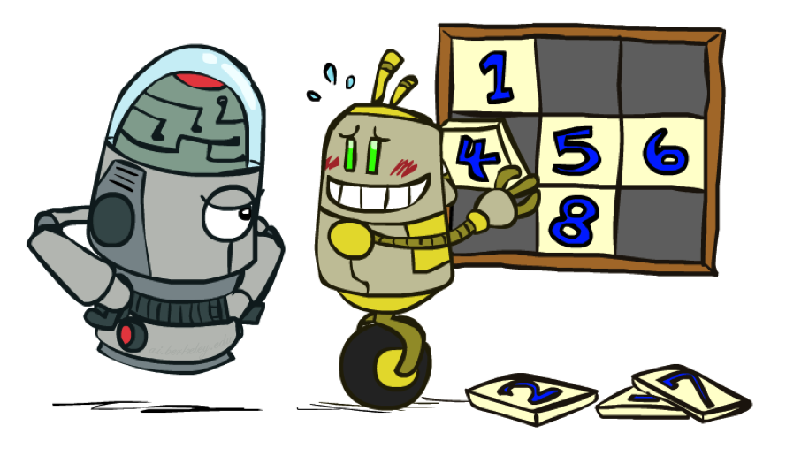
8 Puzzle I
Heuristic: Number of tiles misplaced错误放置的方块
Why is it admissible?
h(start) =
This is a relaxed-problem heuristic
8
Start State
Goal State
 | Average nodes expanded when the optimal path has…
 | …4 steps | …8 steps | …12 steps
UCS | 112 | 6,300 | 3.6 x 10⁶
TILES | 13 | 39 | 227
Statistics from Andrew Moore
Notes:
All are out of position. 8
Each tile either goes into it’s right position or not. Fix one mistake, never more than 1.
Cheating is easier.

Slide 38
8 Puzzle II
What if we had an easier 8-puzzle where any tile could slide any direction at any time, ignoring other tiles?
Total Manhattan distance
Why is it admissible?
h(start) =
Start State
Goal State
 | Average nodes expanded when the optimal path has…
 | …4 steps | …8 steps | …12 steps
TILES | 13 | 39 | 227
MANHATTAN | 12 | 25 | 73
3 + 1 + 2 + … = 18
Notes:
Another relaxation, but “harder” than previous.
Lower bound.
Show it’s relaxed or prove.
At LEAST 18 away.
As heuristic gets close to the true cost, you do less search.

Slide 39
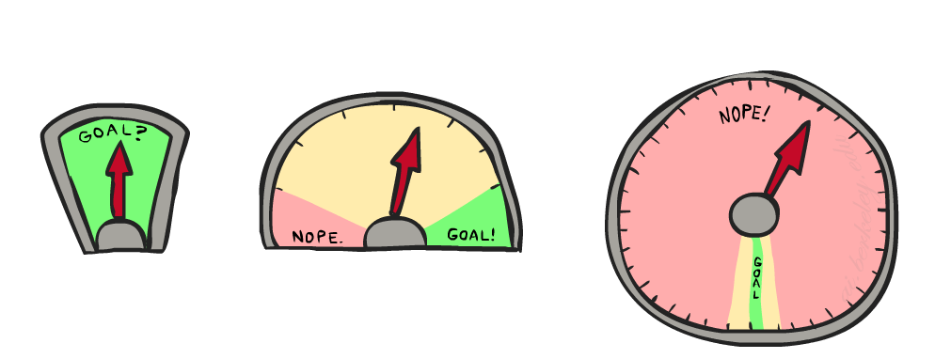
8 Puzzle III
How about using the actual cost as a heuristic? 如果以真实代价做启发？
Would it be admissible? 可采纳吗？
Would we save on nodes expanded? 能减少展开节点数量吗
What’s wrong with it? 问题在哪里？
With A*: a trade-off between quality of estimate and work per node A星是估计质量与所需工作之间的折中。
As heuristics get closer to the true cost, you will expand fewer nodes but usually do more work per node to compute the heuristic itself启发估计越接近真实代价，展开的节点越少，但每个节点所需要的启发估计计算量越大
Notes:
Looks great. Each node launches search as hard as the original problem.
You’ll might see this in P1. Come up with great heuristic, makes solution slower.

Slide 40
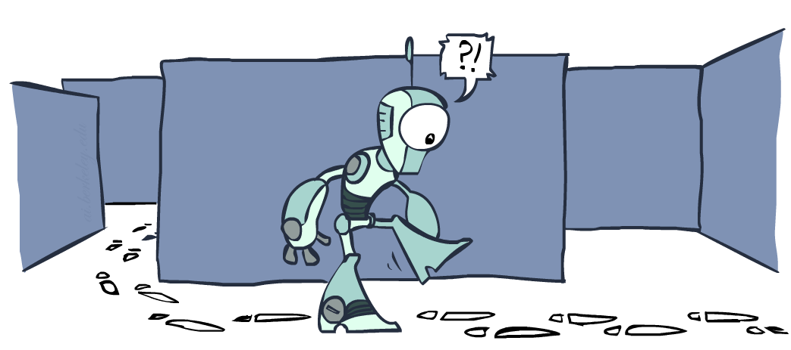
Graph Search
Notes:
~10:40
Lots of repeated work in Tree. Unrolls graph.
Avoid repeated work.

Slide 41
Tree Search: Extra Work!
Failure to detect repeated states can cause exponentially more work. 无法检测重复状态，造成指数级工作量
State Graph
Search Tree
Notes:
Exponential unrolling. Generally what happens.
May need to consider both paths to B, but what’s underneath B is the same.
Should be able to save the work.

Slide 42
Graph Search图搜索
In BFS, for example, we shouldn’t bother expanding the circled nodes (why?)
S
d
e
p
b
c
e
h
r
q
a
a
h
r
p
q
f
p
q
f
q
c
G
q
c
G
a
a
Notes:
Breadth first, so s->e before s->d->e
Everything under is identical. If we know best path from this e to G, we know best path from this e to G.
The circled nodes were already visited earlier. BFS, so earlier means higher or equal and to the left.
How to change algorithm? Easy. Consequences hard.

Slide 43
Graph Search
Idea: never expand a state twice 核心思想：展开一个状态不超过两次
How to implement如何实现:
Tree search + set of expanded states (“closed set”) 搜索树+展开状态集合
Expand the search tree node-by-node, but… 搜索树逐个节点展开，但从不检查重复
Before expanding a node, check to make sure its state has never been expanded before 图搜索在展开一个节点时，先确保该状态从未被展开过
If not new, skip it, if new add to closed set 如果该节点被展开过，则忽略它，如果该节点从未被展开，则将它添加到展开状态集合
Important: store the closed set as a set, not a list 展开状态用集合表示，而非列表。
Notes:
Expand = GetSuccessor called on it.
Don’t enqueue onto fringe if you already did it.
Warning: Some books call it closed list. It is a set, not a list. Membership check is cheap with set.
Completeness okay. Still a path to the goal.
Optimality is tricky. Maybe got the wrong one.

Slide 44
Graph Search
Can graph search wreck completeness? Why/why not? 图搜索是否会破坏完备性？
How about optimality? 是否最优？
Notes:
Expand = GetSuccessor called on it.
Don’t enqueue onto fringe if you already did it.
Warning: Some books call it closed list. It is a set, not a list. Membership check is cheap with set.
Completeness okay. Still a path to the goal.
Optimality is tricky. Maybe got the wrong one.

Slide 45
A* Graph Search Gone Wrong?
State space graph
Search tree
A
S (0+2)
1
S
1
C
h=4
A (1+4)
B (1+1)
h=1
h=2
1
2
C (2+1)
C (3+1)
B
3
G (5+0)
G (6+0)
h=1
G
h=0
Closed Set:
S
B
C
A
Notes:
Need heuristic. This is specification of our abstract problem.
Refuse to expand. Only thing left on fringe is bad G.
Admissible, but not optimal.
If we weren’t doing graph, good G would have appeared, won over bad G.
C used up at the wrong time,

Slide 46
Consistency of Heuristics 启发估计一致性
Main idea: estimated heuristic costs ≤ actual costs
Admissibility: heuristic cost ≤ actual cost to goal
h(A) ≤ actual cost from A to G
Consistency: heuristic “arc” cost ≤ actual cost for each arc
h(A) – h(C) ≤ cost(A to C)
Consequences of consistency: 一致性
The f value along a path never decreases
h(A) ≤ cost(A to C) + h(C)
A* graph search is optimal
A
1
C
h=4
h=1
h=2
3
G
Notes:
Need stronger condition than admisibility.
Single arc. Heuristic don’t score arcs, so take difference.

Slide 47
Optimality of A* Search
With a admissible heuristic, Tree A* is optimal.
With a consistent heuristic, Graph A* is optimal.
See slides, also video lecture from past years for details.
With h=0, the same proof shows that UCS is optimal.
Notes:
I like fall 2013 on edx.org by Dan Klein because it’s edited.

Slide 48
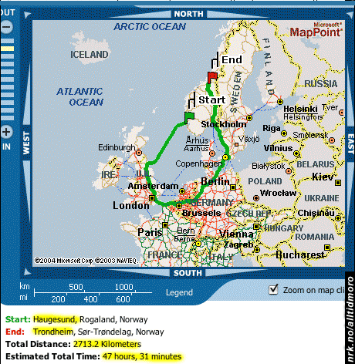
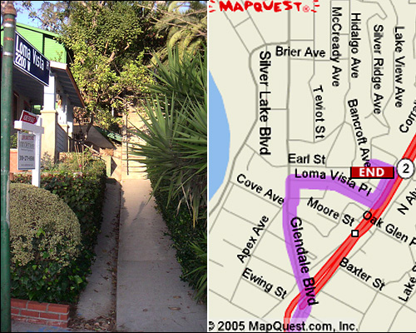

Search Gone Wrong?
Notes:
Search operates over MODELS.
Agent doesn’t actually try the paths – all in simulation.
Search is only as good as model.
Probably end here. If time, go through summary.

Slide 49

A*: Summary

Slide 50

A*: Summary
A* uses both backward costs and (estimates of) forward costs
A* is optimal with admissible / consistent heuristics
Heuristic design is key: often use relaxed problems
Notes:
Heuristic is cheaper than reality.

Slide 51
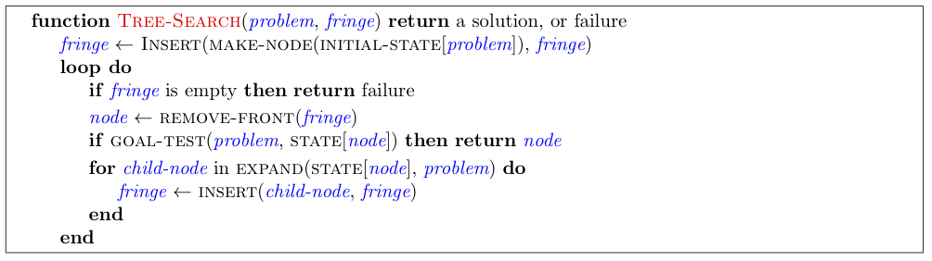
Tree Search Pseudo-Code

Slide 52
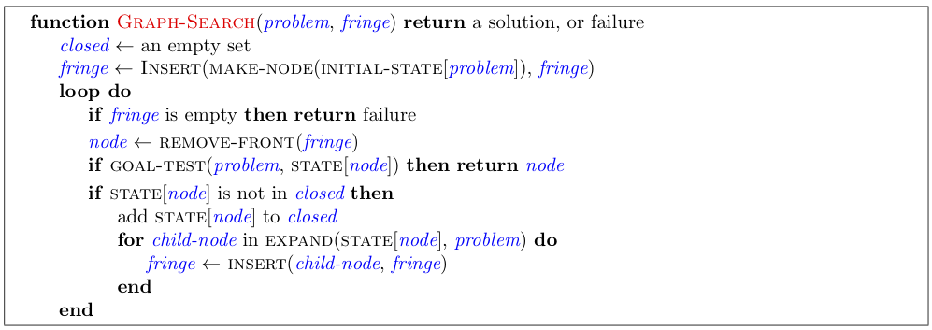
Graph Search Pseudo-Code

Slide 53
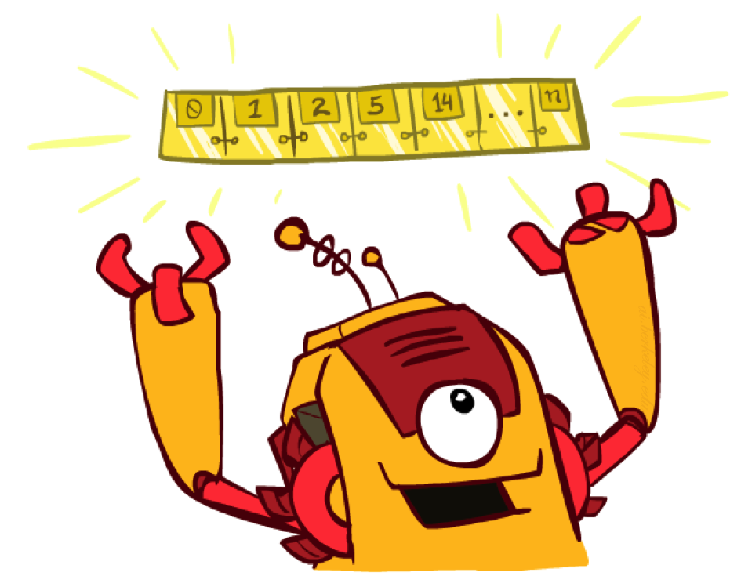
The One Queue
All these search algorithms are the same except for fringe strategies
Conceptually, all fringes are priority queues (i.e. collections of nodes with attached priorities)
Practically, for DFS and BFS, you can avoid the log(n) overhead from an actual priority queue, by using stacks and queues
Can even code one implementation that takes a variable queuing object

Slide 54
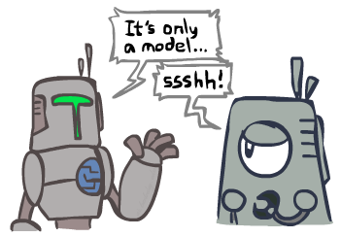
Search and Models
Search operates over models of the world
The agent doesn’t actually try all the plans out in the real world!
Planning is all “in simulation”
Your search is only as good as your models…
Notes:
All in your head.

Slide 55
Search Gone Wrong?
Notes:
Next time – guided search where you know something about direction of solution.

